Slide 1
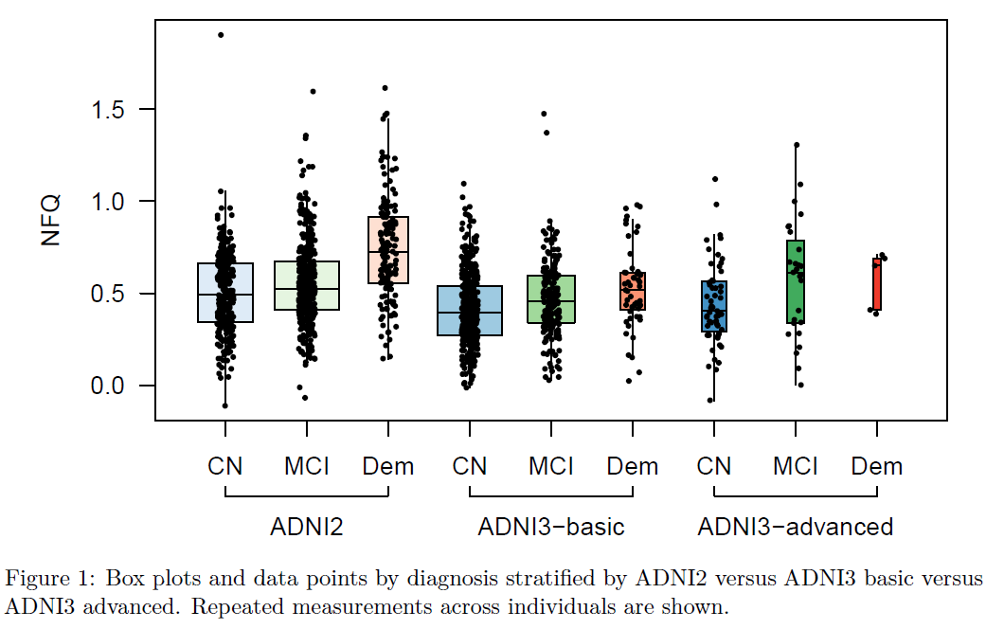
Step from ADNI 2 to ADNI 3
CN vs MCI separation slightly greater with advanced

Slide 2
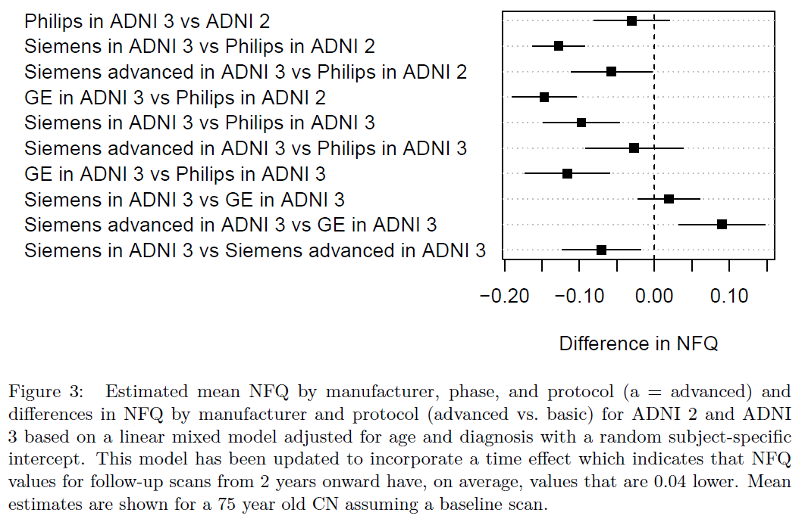
effects of ADNI phase (2 vs 3), scanner model, and protocol (basic vs advanced)
Conclusion: adjust for scanner and protocol

